Slide 1
CS1231 Tutorial 8
AY18/19 – WEEK 10
Andrew Tan

Slide 2
Probability
Probability is a measure of the likelihood that an event will occur
Counting refers to the techniques used to count the set of possible outcomes

Slide 3
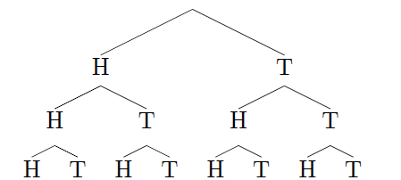
Possibility trees
E.g. Flipping 3 coins

Slide 4
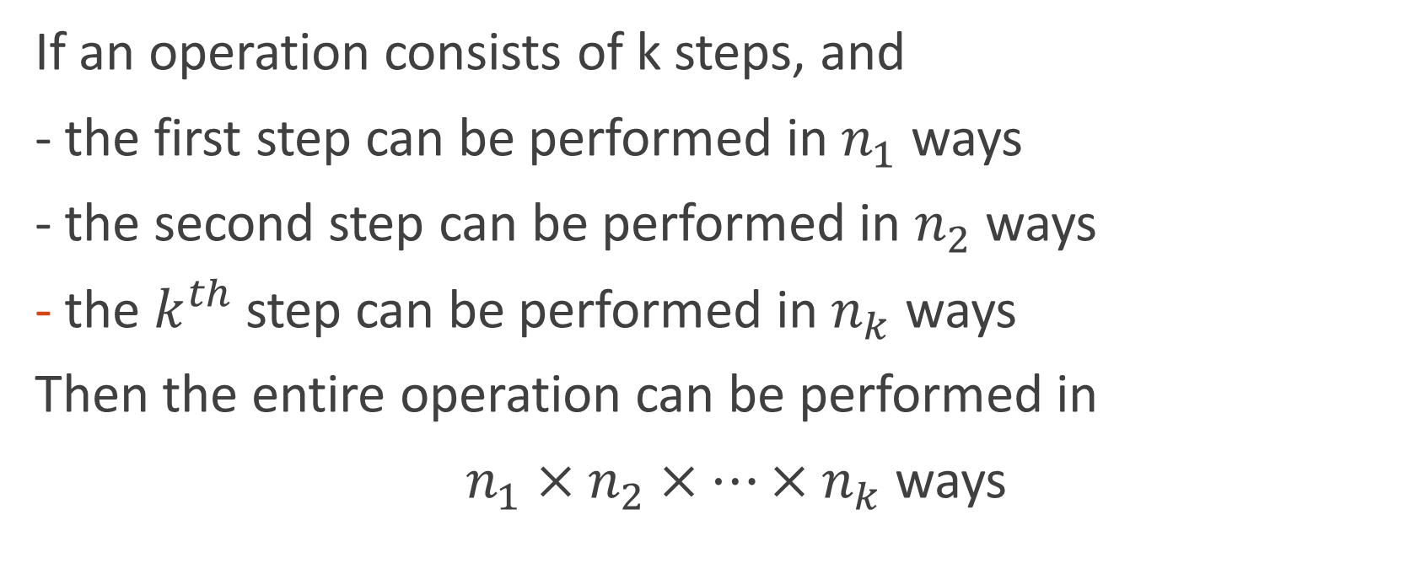
Multiplication rule
If an operation consists of k steps, and
- the first step can be performed in $n_{1}$ ways
- the second step can be performed in $n_{2}$ ways
the $k^{th}$ step can be performed in $n_{k}$ ways
Then the entire operation can be performed in
$n_{1}×n_{2}×…×n_{k}$ ways

Slide 5
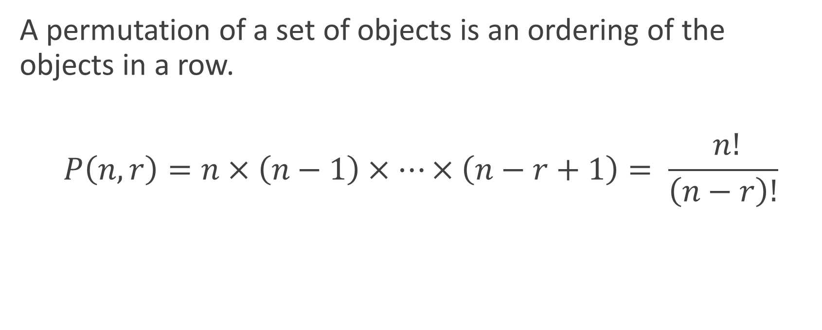
Permutations
A permutation of a set of objects is an ordering of the objects in a row.
$$P\left(n,r\right)=n×\left(n−1\right)×…×\left(n−r+1\right)= \frac{ n!}{\left(n−r\right)!}$$

Slide 6
Counting elements of disjoint sets
Addition rule: the number of elements in a union of mutually disjoint finite sets = the sum of the number of elements in the component sets

Slide 7

Inclusion/Exclusion rule
Generalized addition rule (applicable to sets that are not disjoint)
$$N\left(A∪B\right)=N\left(A\right)+N\left(B\right)−N(A∩B)$$
$$N\left(A∪B∪C\right)=N\left(A\right)+N\left(B\right)+N\left(C\right)−N\left(A∩B\right)−N\left(A∩C\right)−N\left(B∩C\right)+N(A∩B∩C)$$

Slide 8
Pigeonhole Principle
A function from one finite set to a smaller finite set cannot be one-to-one: there must be at least 2 elements in the domain that have the same image in the co-domain.
Basically, if pigeons > pigeonholes, then some pigeonholes need to take in more than 1 pigeon

